Slide 1


Slide 2



Slide 3
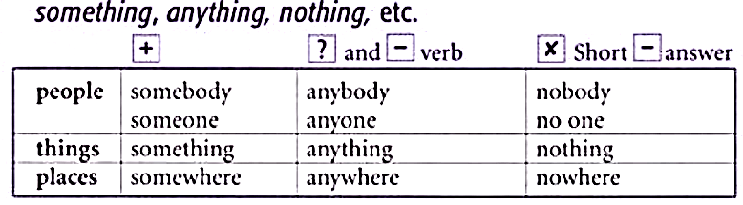
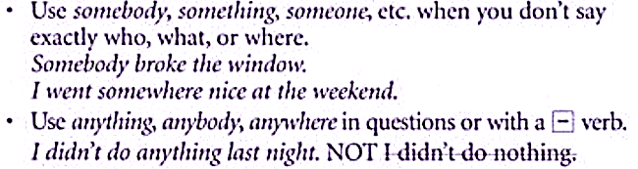

Slide 4
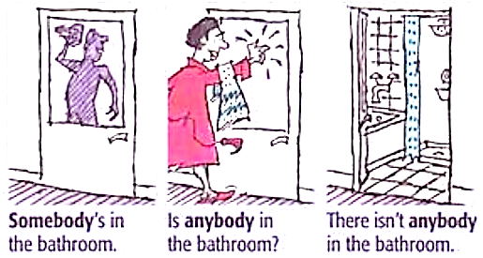
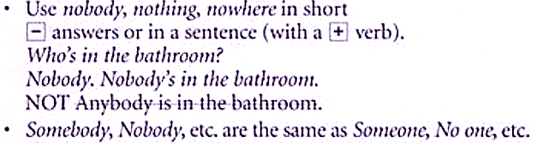

Slide 5
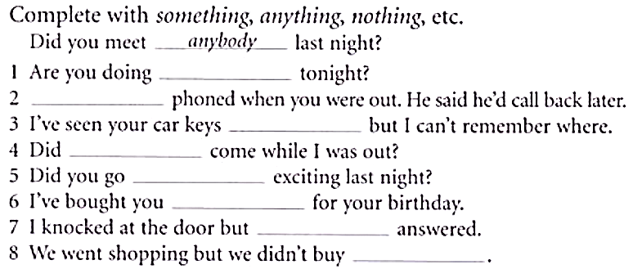

Slide 6
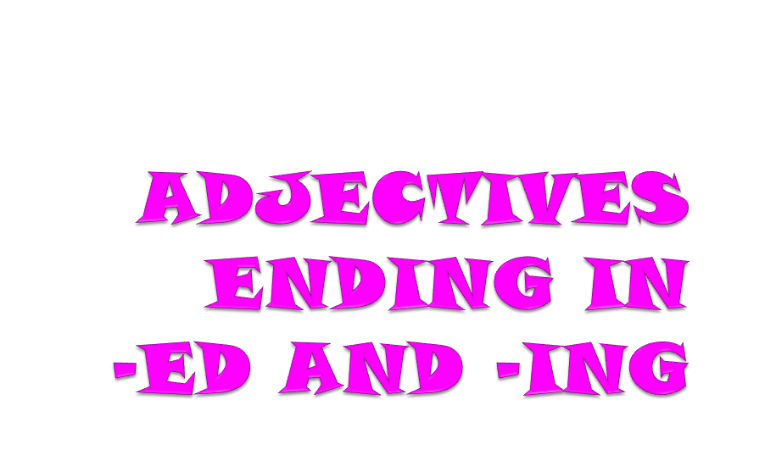

Slide 7
Look at these examples to see how adjectives ending in -ed and -ing are used:
I was really bored in that presentation.
That was a really boring presentation.

Slide 8
Grammar explanation
Adjectives that end in -ed (e.g. bored, interested) and adjectives that end in -ing (e.g. boring, interesting) are often confused.
* -ed adjectives
Adjectives that end in -ed generally describe emotions – they tell us how people feel.
I was so bored in that lesson, I almost fell asleep.
He was surprised to see Helen after all those years.
She was really tired and went to bed early.
* -ing adjectives
Adjectives that end in -ing generally describe the thing that causes the emotion – a boring lesson makes you feel bored.
Have you seen that film? It's really frightening.
I could listen to her for hours. She's so interesting.
I can't sleep! That noise is really annoying!

Slide 9
Exercise
- Shock:
“The news was ………………………..”
“I was ………………………. when I heard the news.”
- Interest:
“I think football is ……………………….”
“I am……………………… by football.”
- Disappoint:
“The firework display was ……………………….”
“We were ……………………… by the pathetic firework display.”
- Surprise:
“It was ……………………… that she passed her driving test.”
“I was ……………………… that she passed her driving test.”

Slide 10
Keys
- Shock:
“The news was shocking.”
“I was shocked when I heard the news.”
- Interest:
“I think football is interesting.”
“I am interested by football.”
- Disappoint:
“The firework display was disappointing.”
“We were disappointed by the pathetic firework display.”
- Surprise:
“It was surprising that she passed her driving test.”
“I was surprised that she passed her driving test.”

Slide 11
Here are some adjectives that can have both an -ed and an -ing form.
annoyed | annoying
bored | boring
confused | confusing
disappointed | disappointing
excited | exciting
frightened | frightening
interested | interesting
surprised | surprising
tired | tiring
worried | worrying

Slide 12






Slide 13


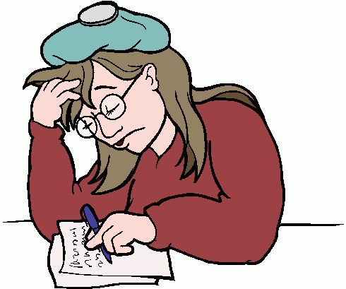

Slide 14

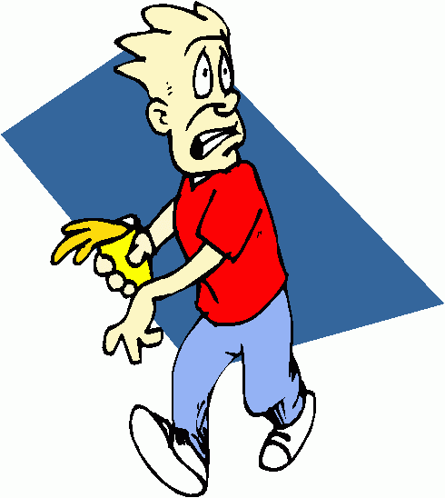


Slide 15
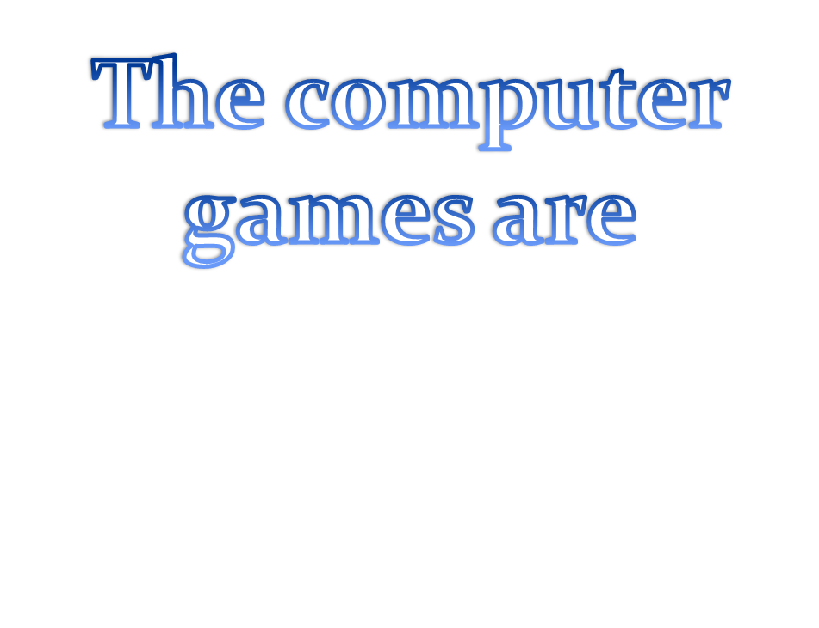

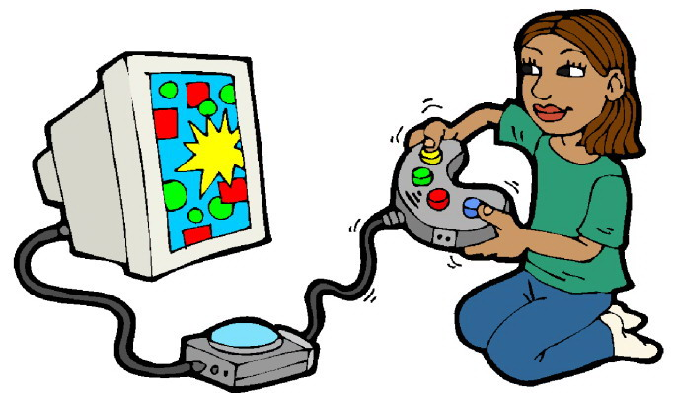


Slide 16


